Slide 1

CLASSIFICATION REPORT
Group No. 4-
Hemamba Devi Majeti
Mr. Vasanth Kumar S.
Vaibhavi Taide
Miss Shraddha Vinayak Mali
Mentored by Mr.Varun & Ms.Ramya

Slide 2
Business objective
This is a classification project since the variable to be predicted is binary (churn or loyal customer). The goal here is to model churn probability, conditioned on the customer features.

Slide 3
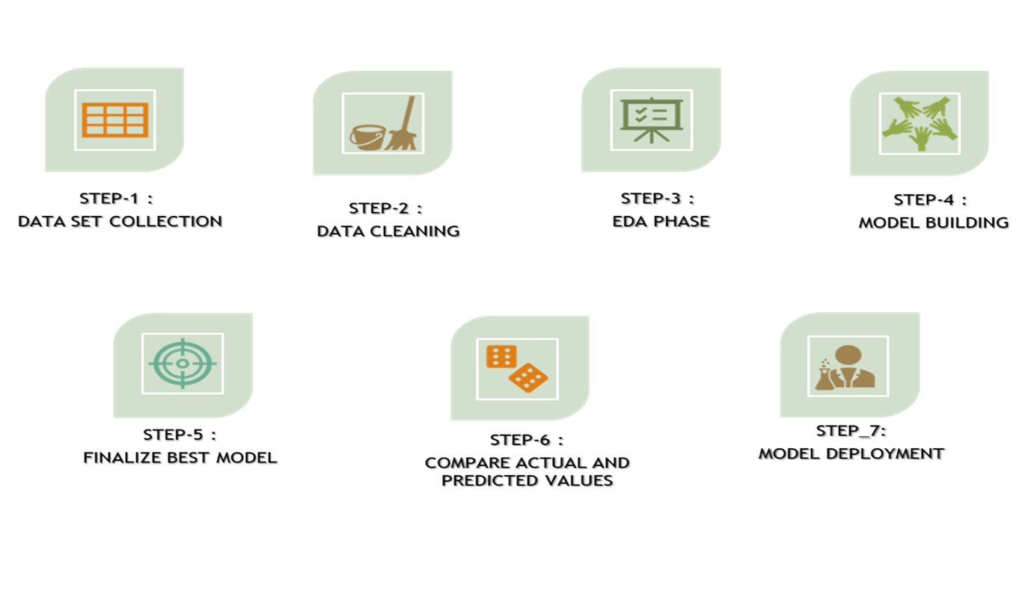
Project Architecture / Project Flow

Slide 4
Exploratory Data Analysis (EDA) and
Feature Engineering

Slide 5
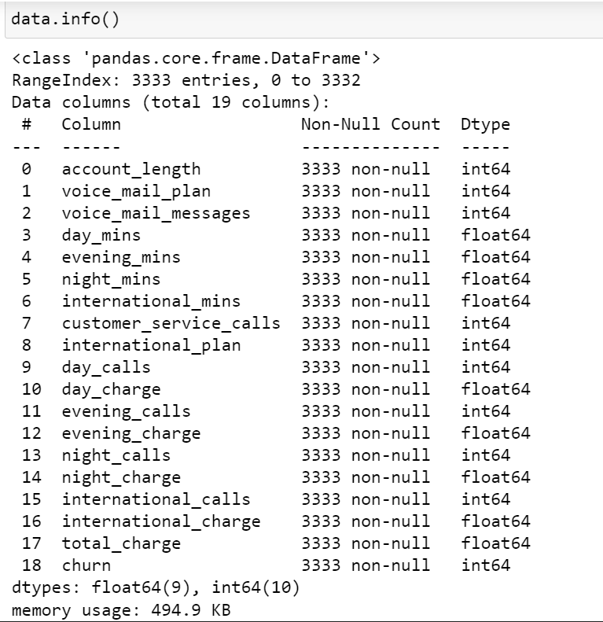
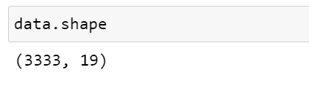
Data set details
There are 3333 Observations and 19 Features in the dataset.
There are no null values.
The data types are Integer and Float.

Slide 6
Exploratory Data Analysis (EDA)
In the given dataset, the first 18 features are the independent variables while the 19th feature i.e. the ‘churn’ column is a dependent variable and is in the categorical form.

Slide 7
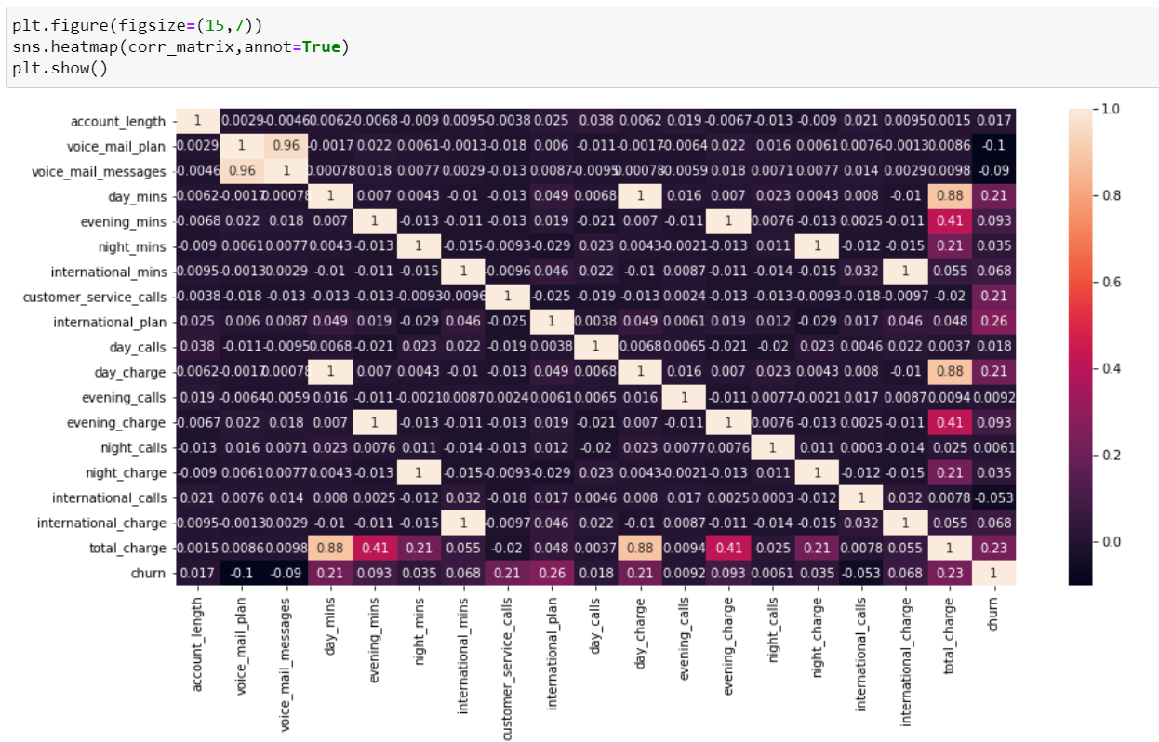
Heatmap Analysis
From the Heatmap we can see that there is
no significant correlation between the independent variables.

Slide 8
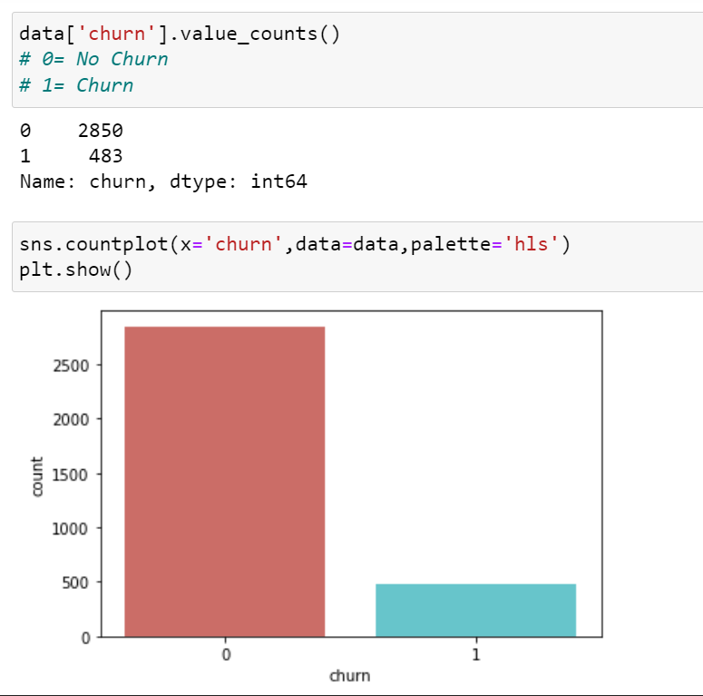
Countplot for the dependent variable
The column ‘Churn’ is the dependent variable. The countplot shows the count of 0 and 1, where 0 is No Churn Customers and 1 is Churning Customers.
From the plot we can see that this is a highly imbalanced dataset.

Slide 9
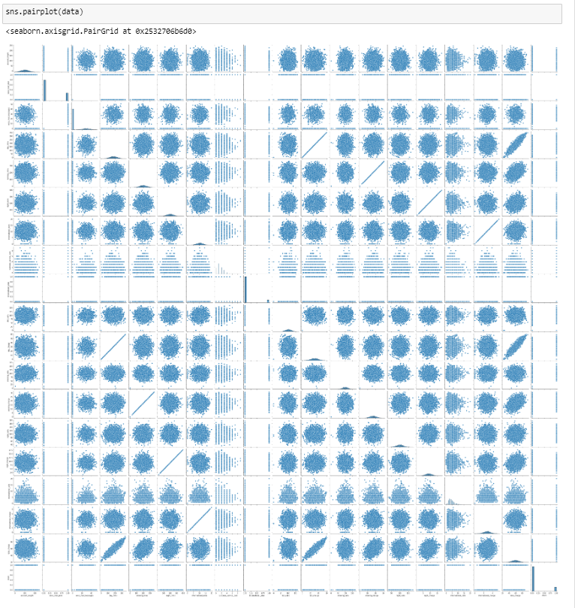
Outlier detection through plotting
Pairplot

Slide 10
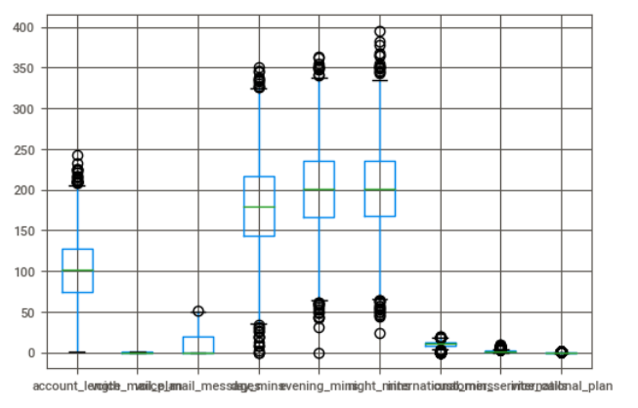
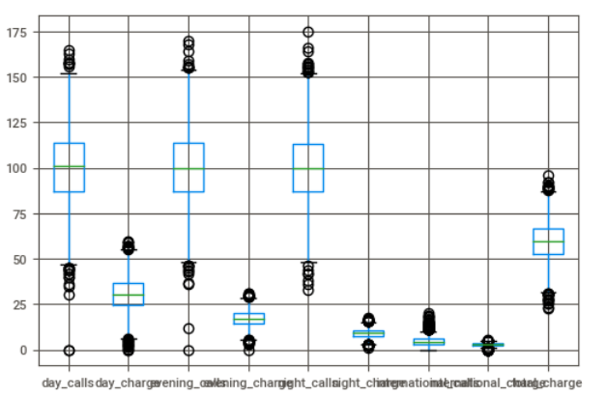
Boxplot
From the boxplot we can see that some features are having outliers.

Slide 11
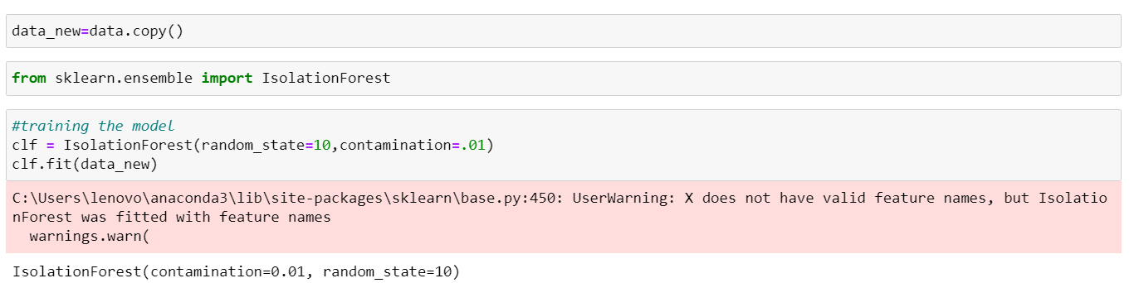
Outlier detection using isolation forest
The results from the Isolation Forest have shown that there are 34 outliers in the given dataset.

Slide 12
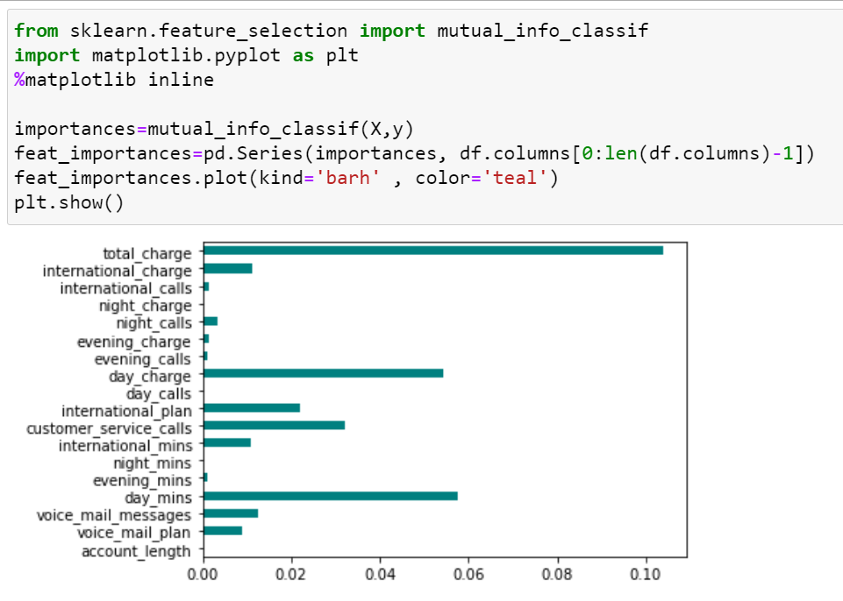
Feature engineering
Feature Engineering shows which features are more important in the dataset.
Here we can see that ‘total_charge’, ‘day_charge’, ‘day_mins’ are the significant features which can affect the dependent variable.

Slide 13
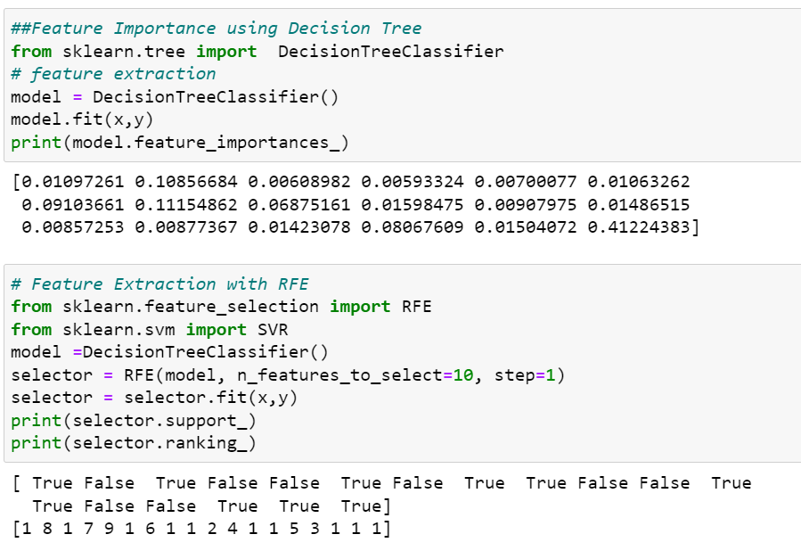
Feature importance

Slide 14
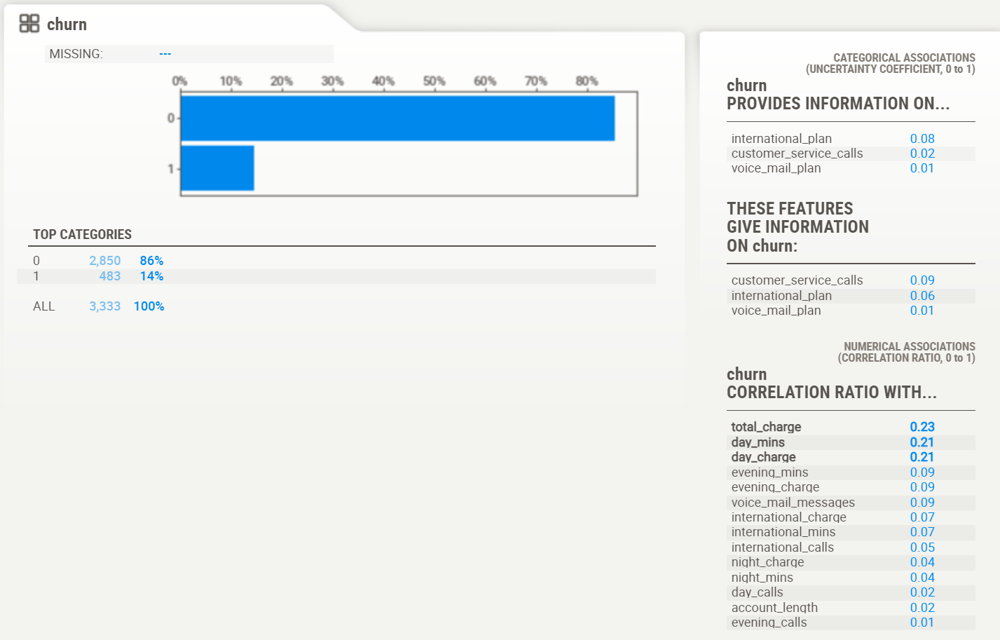
Sweetviz report
This is a Sweetviz Report for the dependent variable.
From this we can see that no independent variable is affecting the dependent variable significantly.
total_charge, day_mins, day_charge are the features that are affecting the dependent variable the most.

Slide 15
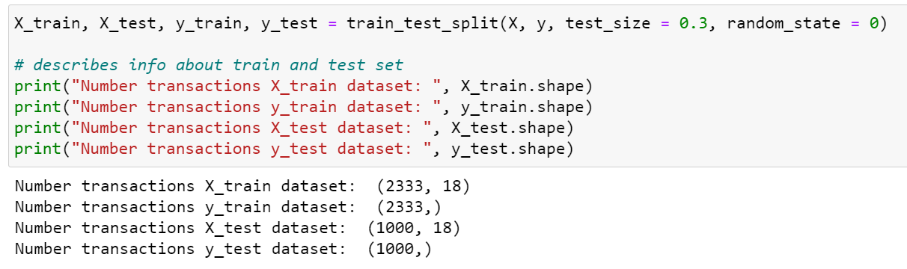
Training the dataset
We have trained the data in 70:30 ratio where 70% of the dataset will be trained and 30% will be tested based on the training.
Model

Slide 16
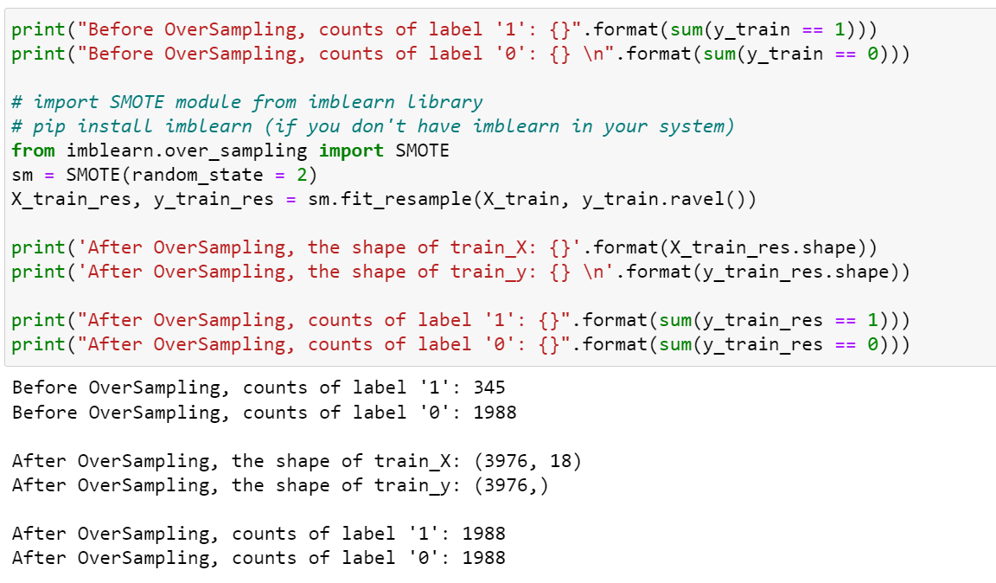
Balancing the dataset
As we know that this is an imbalanced dataset, we have first balanced it using SMOTE technique.
This technique oversamples the dataset and then trains it.

Slide 17
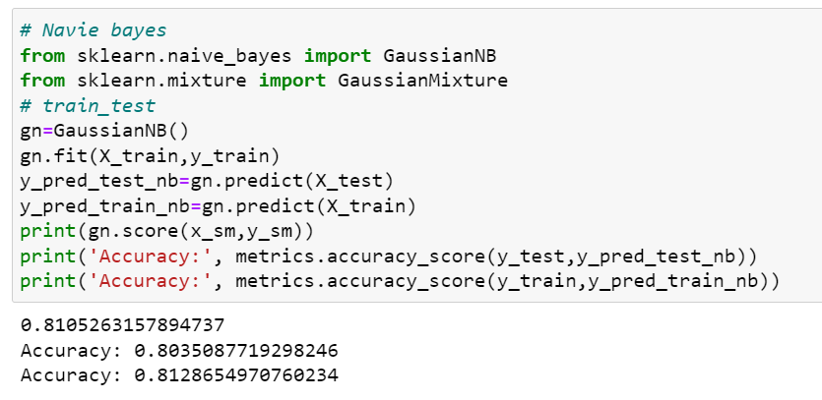
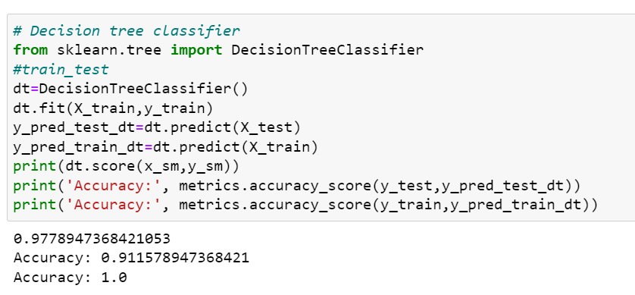
Model building
NAÏVE BAYES
DECISION TREE

Slide 18
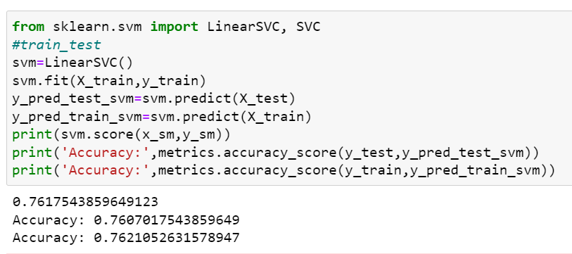
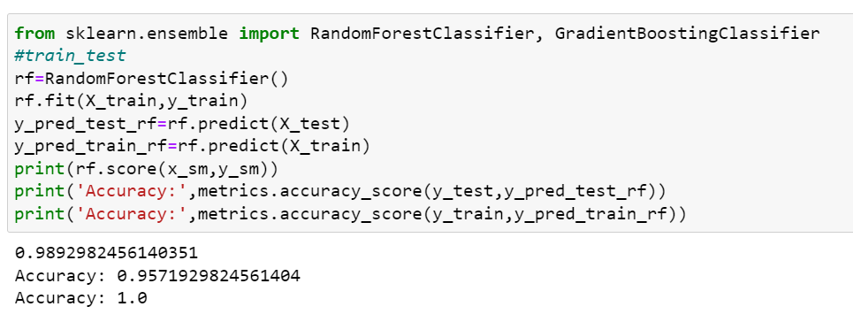
MODEL BUILDING
SVM
RANDOM FOREST

Slide 19
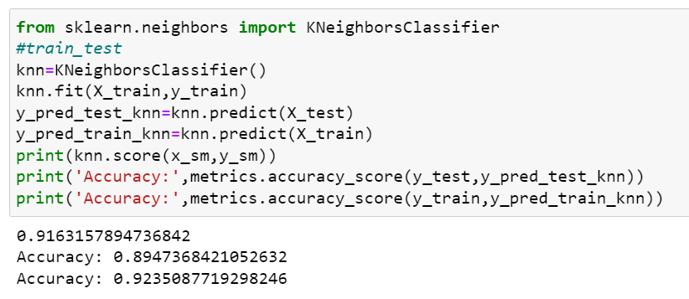
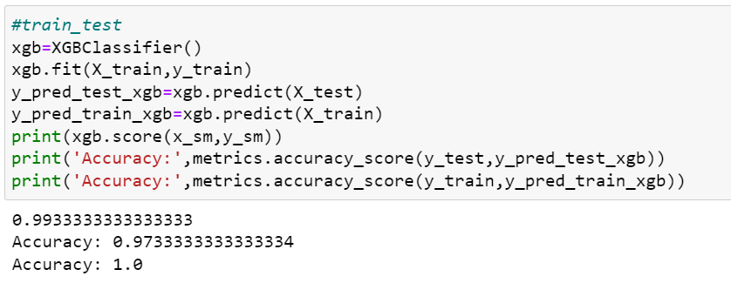
MODEL BUILDING
KNN
XGBOOST

Slide 20
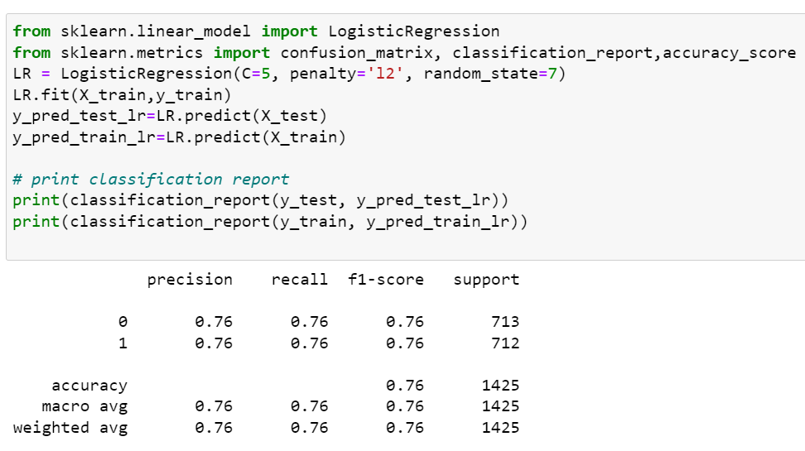
MODEL BUILDING
LOGISTIC REGRESSION

Slide 21
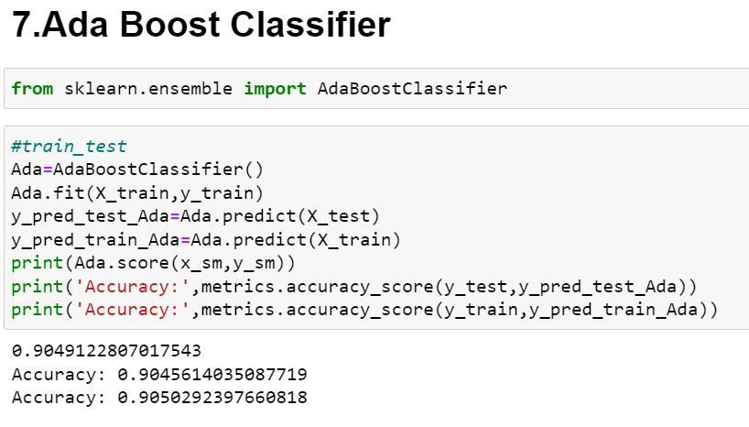
MODEL BUILDING
From all the models built XGBoost has given the highest accuracy of 93%.
It’s RMSE value is also the lowest. Lower the RMSE value more the accuracy of the model.

Slide 22
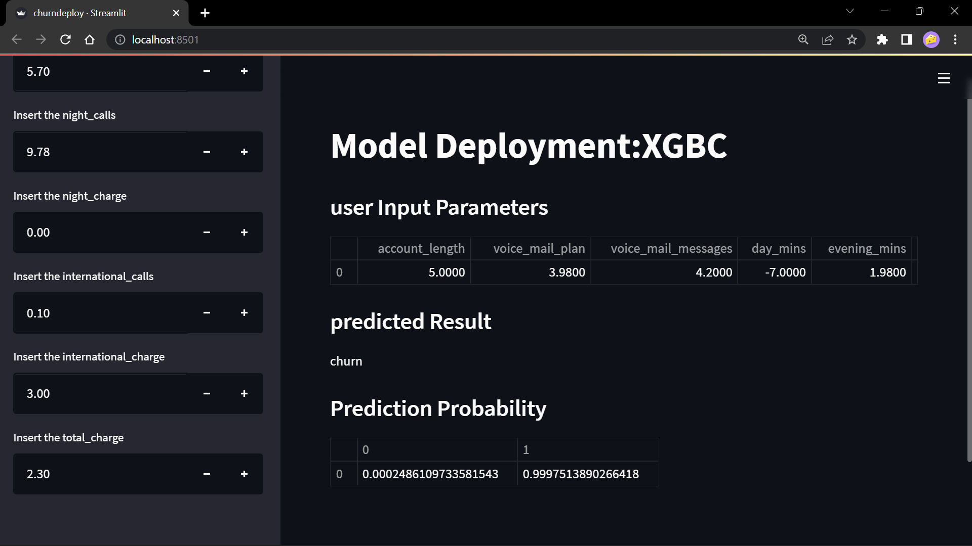
Model deployment using streamlit

Slide 23
challenges
How did you overcome it?
What challenges did you face?
The data was highly imbalanced.
To get the accurate results for the models we had to first balance the dataset. For that we have used the SMOTE technique. It oversamples the dataset and then trains and tests it.

Slide 24
THANK YOU

